Slide 1

Week03 - The ViewController Lifecycle
In the AI Era(Swift + SwiftUI)
Instructor : Mr. Nem Sothea
nemsothea13@gmail.com

Slide 2
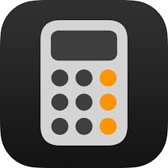
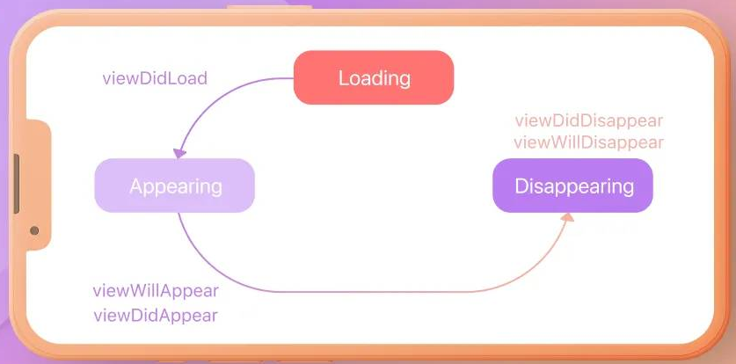
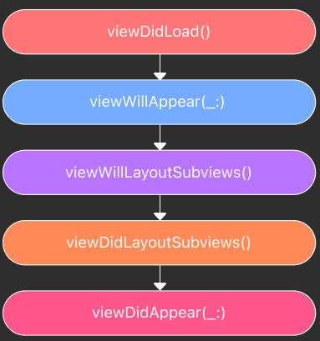
How Your Screens Load, Appear, and Disappear

Slide 3
How Your Screens Load, Appear, and Disappear
viewWillDisappear(_: )
  This is a good place to save user data and cancel network tasks since it is called just before it is about to disappear from the view hierarchy.
viewDidDisappear(_: )
  This function is called when the view disappears from the view hierarchy. Thus, the view is already disappeared from the user's view. Tasks like cancelling the data or ending the analytic events can be performed once the view is disappeared.
Conclusion:
Understanding the life cycle functions are important to make the most of these functions.

Slide 4
What is a ViewController?
A UIViewController manages a single "screen" or a portion of a screen in your app.
It's responsible for:
  Managing Views: Creating, arranging, and updating the UI elements
  Handling User Interaction: Responding to taps, swipes, and other evens.
  Coordinating with Data: Loading and displaying the data for that screen.
Think of it as the boss of its area of the screen.

Slide 5
The Concept of a "Lifecycle"
A ViewController doesn't just appear and disappeared.
It goes through a well-defined sequence of steps from the moment it's created until it's destroyed.
Why does this matter?
  Performance: You want to do expensive tasks (like loading data) at the right time.
  Memory: You need to clean up when you're done to avoid memory leaks.
  User Experience: You want the UI to be smooth and responsive.

Slide 6
The Key Lifecycle Methods
UIKit calls these methods on your ViewController automatically.
Your job is to override them to add your own custom behavior.
The main ones we care about:
  viewDidLoad()
  viewWillAppear(_:)
  viewDidAppear(_:)
  viewWillDisappear(_:)
  viewDidDisappear(_:)

Slide 7
viewDidLoad() - The "Setup" Phase
Called once: When the ViewController's view is first loaded into memory.
The view property is available, but the view is not yet on the screen.
Perfect for:
  One-time initial setup.
  Setting up your UI elements (outlets are connected!).
  Starting to fetch data from a network or database.
overridefunc viewDidLoad() {
super.viewDidLoad( ) // MUST call super first
print("The view has loaded!")
titleLabel.text = "Welcome!"
fetchUserData() // Kick off a network call
}

Slide 8
viewWillAppear(_:) - The "About to Show" Phase
Called every time the view is about to be added to the screen and become visible.
The view is loaded, but not yet visible.
Perfect for :
  Refreshing data that might have changed (e.g., on a screen you're returning to).
  Starting animations that should begin as the view appears.
  Hiding/showing UI elements based on the current state.
overridefunc viewWillAppear(_ animated: Bool) {
super.viewWillAppear(animated)
print("The view is about to appear!")
updateUserStatusDisplay() // Refresh the UI
}

Slide 9
viewDidAppear(_:) - The "Now Visible" Phase
Called after the view has been fully transitioned onto the screen.
The view is now fully visible and interactive.
Perfect for:
  Starting long-running animations.
  Starting tasks that require the user's attention (like playing a video).
  Careful: This is often too late for initial data loading (use viewDidLoad).
overridefunc viewDidAppear(_ animated: Bool) {
super.viewDidAppear(animated)
print("The view is now visible!")
startBackgroundAnimation()
}

Slide 10
The Disappear Sequence
viewWillDisappear(_:): Called just before the view is removed from the screen. Perfect for pausing tasks or saving user input.
viewDidDisappear(_:): Called after the view has been fully removed. Good for cleaning up resources that are no longer needed.
overridefunc viewWillDisappear(_ animated: Bool) {
super.viewWillDisappear(animated)
print("Goodbye! The view will disappear.")
saveFormData() // Save the user's work
}
overridefunc viewDidDisappear(_ animated: Bool) {
super.viewDidDisappear(animated)
print("The view is gone.")
stopVideoPlayer() // Clean up resources
}

Slide 11
Visualizing the Lifecycle
State Transition Functions
viewDidLoad()
  This is called after the view is loaded in to memory, and is commonly thought of as the first method that will be called. Majority of the view configurations and API setups are done here
viewWillAppear(_: )
  This method is called use before the View Controller is added to the view hierarchy. The frame and bounds of the view controller are all set. This function is called each time the view is presented on screen.
[ViewController Created]
viewDidLoad() (Once)
viewWillAppear(_:) (Every time)

Slide 12
Live Demo: Let's Add Logging

Slide 13
Creating Views in Code
So far, we've used Storyboards. But you can also create your UI entirely in code!
viewDidLoad() is the perfect place to do this initial creation and adding of subviews.
let nameLabel = UILabel() // 1. Create a view
overridefunc viewDidLoad() {
super.viewDidLoad()
nameLabel.text = "Sothea"// 2. Configure it
nameLabel.frame = CGRect(x: 50, y: 100, width: 200, height: 40) // 3. Set its size & position
view.addSubview(nameLabel) // 4. Add it to the screen
}

Slide 14
Practice Exercises
Goal: Solidify your understanding of the ViewController lifecycle.
Task 1 (The Logger): Create a new "Single View App" project.
  Override all five key lifecycle methods.
  In each one, add a unique print() statement (e.g., "viewDidLoad called").
  Run the app and record the order of messages in the console.
  Navigate away from the app (using the Home button) and back again. Record the new order.
Task 2 (Code UI): In the same project, add a button entirely in code within the viewDidLoad() method. Make tapping this button change the background color of the main view. (Hint: The button's action can call a function you write, like func changeColor() { ... }).

Slide 15
Homework Assignment
// Case 1: GET Requests
  - Fetch data from JSONPlaceholder
  - Parse JSON response
  - Display in UITableView
// Case 2: Error Handling
  - Network error scenarios
  - Loading states
  - Empty states
// Case 3: Handle response
  - Handle responses

Slide 16
Key Takeaways
ViewControllers have a lifecycle managed by UIKit.
viewDidLoad() is for one-time setup. The view is loaded but not on screen.
viewWillAppear/viewDidAppear are called whenever the view is about to be/is shown.
viewWillDisappear/viewDidDisappear are called whenever the view is about to be/is hidden.
You can create and configure UI elements entirely in code, and viewDidLoad() is a great place to start.

Slide 17
Questions?
Next Week: Navigation - Moving between multiple screens!
Thank you!

